Slide 1
Interactive Physics-Based Virtual Sculpting with Haptic Feedback i3D 2022
Avirup Mandal, Parag Chaudhuri, Subhasis Chaudhuri
Indian Institute of Technology Bombay

Slide 2
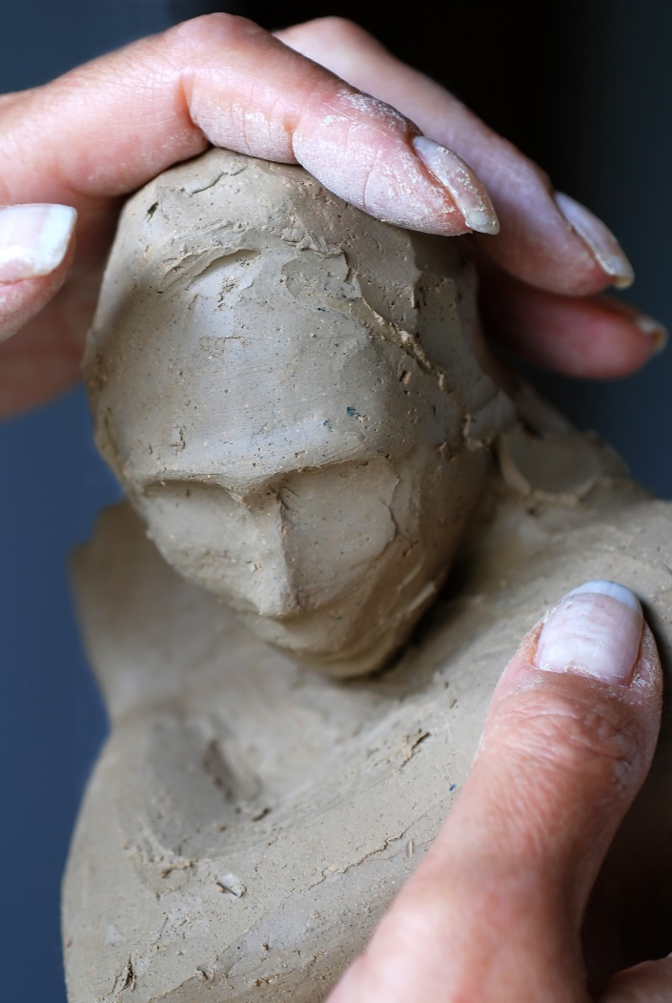
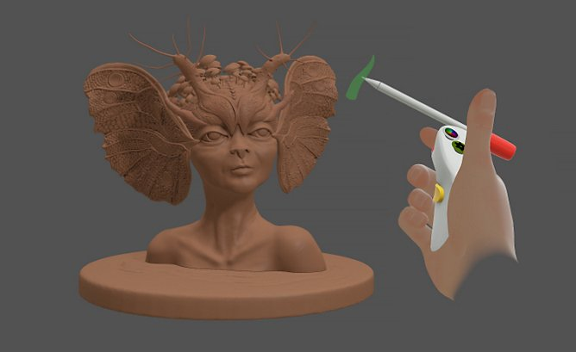
Motivation
Real vs Virtual Sculpting
Sculpting relies on visual and tactile feedback.
Virtual sculpting has a paucity of feedback.
Source: https://www.adobe.com/products/medium.html
Source: https://www.sierravistaaz.gov/hands-sculpting-clay-figure/

Slide 3
Motivation
Make the virtual sculpting experience more accurate & immersive
Physics-based sculpting
Haptic feedback
Virtual Sculpting

Slide 4
Contributions
Building a virtual sculpting solution with visual as well as haptic feedback.
Developed a remeshing-free Is-XFEM based cutting algorithm.
Synchronized haptic and visual feedback using a multi-resolution, multi-timescale method.
Part of the simulations are parallelized using GPU to meet the real-time constraints.

Slide 5
Prior Art
Remeshing-Free Cutting Algorithms
XFEM algorithms: Enrichment of nodes to add DOFs for independent movement of disjoint pieces. [Chitalu et al. 2020][Koschier et al. 2017]
Is-XFEM algorithms: More stable than XFEM. [Wu et al. 2015]
Haptic Rendering of Solids
Constrained-based haptic rendering: Haptic force feedback is calculated using difference of acceleration between God object and haptic proxy. [Ortega et al. 2007]
Penalty-based haptic rendering: Haptic force feedback is calculated using depth of penetration of haptic proxy. [Xu et al. 2017]
Virtual Sculpting
Cube grid based field sculpting: Use cube grid to model volumetric mesh. [Chen et al. 2002]
Displacement map sculpting: Use displacement map for 2D surface manipulation. [Jagnow et al. 2002]
B-spline based sculpting: Use B-spline to deform surfaces. [Gao et al. 2006]

Slide 6
Prior Work: Deformation & Wetting
Simulated Corotated FEM based deformation with linear Cauchy strain on volumetric tetrahedral mesh. [Müller et el. 2004]
Wetting brush that transfer water from the brush to mesh. [Patkar et al. 2013]
Water gets diffused between neighboring tetrahedra. [Patkar et al. 2013]
Increasing the water content inside a tetrahedral element makes the material is made more malleable. [Mandal et al. 2021]

Slide 7
Multi-resolution Simulation Framework
Problem:
High-resolution mesh slows down the simulation speed.
Low-resolution mesh affects visual fidelity.
Solution:
Embed a high-resolution triangular surface mesh for visualization inside a low-resolution tetrahedral volume mesh.
Sculpting operations are first performed on the low-resolution mesh.
Transferred to the high-resolution mesh using barycentric co-ordinates.

Slide 8
Multi-timescale Framework
Continuous collision detection between cutting tool and outer-surface of the mesh being sculpted.

Slide 9
Multi-timescale Framework
Continuous collision detection between cutting tool and outer-surface of the mesh being sculpted.

Slide 10
Multi-timescale Framework
Continuous collision detection between cutting tool and outer-surface of the mesh being sculpted.

Slide 11
Multi-timescale Framework
Continuous collision detection between cutting tool and outer-surface of the mesh being sculpted.

Slide 12
Multi-timescale Framework
Continuous collision detection between cutting tool and outer-surface of the mesh being sculpted.
Problem:
HAPTICS
THREAD
VISUAL
THREAD
Smooth haptics feedback requires 1000 frames/sec update.
Visual feedback requires at least 60 frames/sec.
Solution:
Two parallel threads: Haptics & Visual.
Synchronization: shared memory.
Rapid update of forces on haptics thread by filtering.
SHARED MEMORY

Slide 13
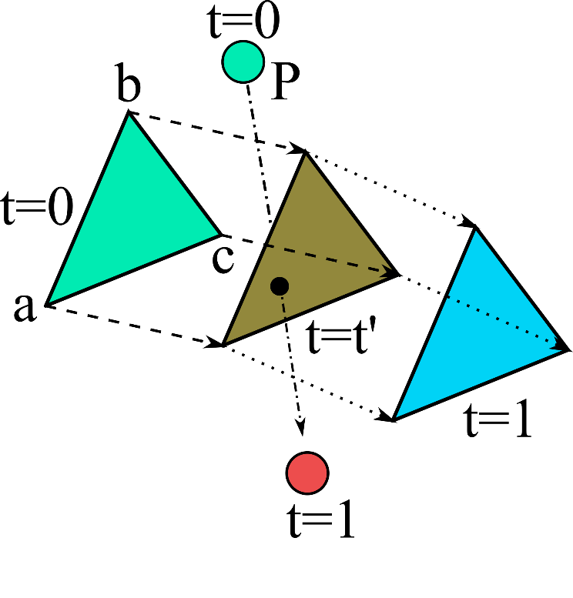
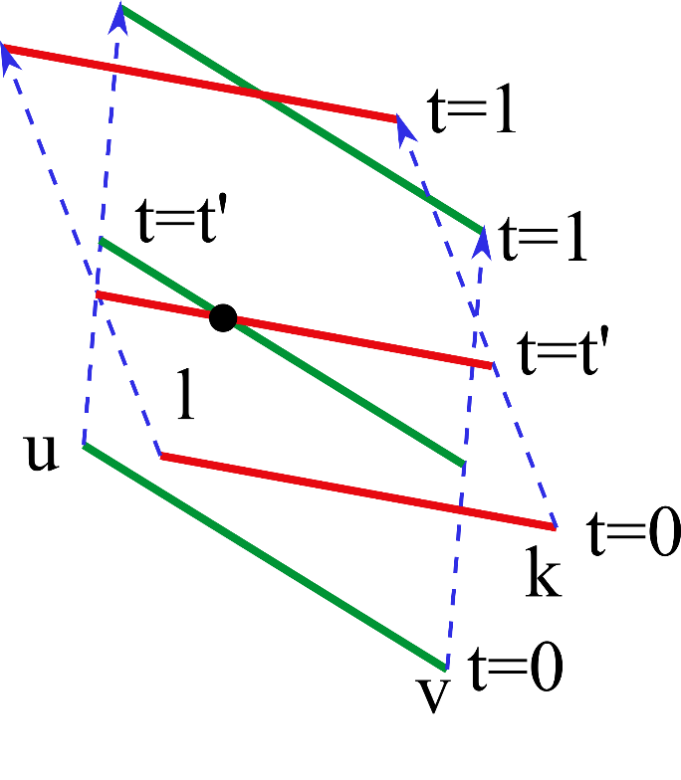
Haptic Force Feedback
Calculate Vertex-Face penalty force as
$$I_{p}^{VF}=k_{vf}\sum_{i=0}^{i<N}{\int_{t_{a}^{i}}^{t_{b}^{i}}{n_{t}^{T}}(p_{t}−q_{t})n_{t}dt}$$
Calculate Edge-Edge penalty force
$$I_{p}^{EE}=k_{ee}\sum_{i=0}^{i<N}{\int_{t_{a}^{i}}^{t_{b}^{i}}{n_{E_{t}}^{T}}(p_{t}−q_{t})n_{E_{t}}dt}$$

Slide 14
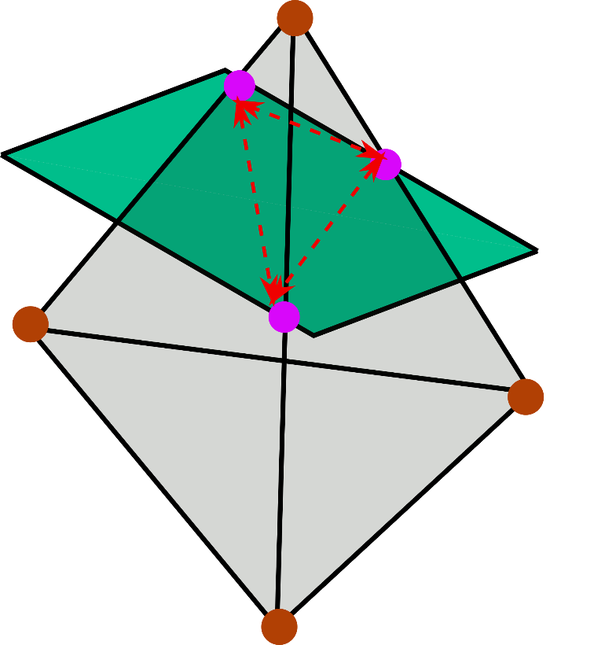
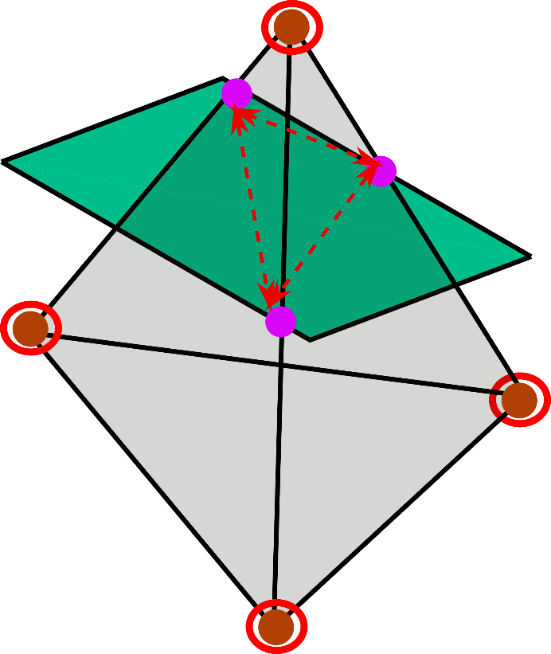
Cutting: Is-XFEM
Find closed loop intersection of the cut tool and tetrahedral element and haptic force threshold.
Enrich the corresponding nodes. Enrichment denotes extra degrees of freedom.
$u^{∗}\left(ζ,t\right)=\sum_{i=1}^{n_{v}}{N_{i}\left(ζ\right)u_{i}(t)}+\sum_{j=1}^{m}{\sum_{i=1}^{n_{v}^{enr}}{ψ_{i}^{j}(ζ)N_{i}\left(ζ\right)u_{i}^{j} (t)}}$
The enrichment function.
$$ψ_{i}^{j}\left(ζ\right)=H_{s}\left(Φ^{j}\left(ζ\right)\right)−\left[kγ\left(ζ\right)+\left(1−k\right)H_{s}(Φ^{j}\left(ζ_{i}\right))\right]$$
Linear interpolant.
$$γ\left(ζ\right)=\sum_{i=1}^{n_{v}}{N_{i}\left(ζ\right)}H_{s}\left(ζ_{i}\right)$$

Slide 15
Cutting: Updated Parameters
For any Tetrahedron ‘e’ which has ‘j’ number of cuts.
Mass using enrichment function
$$m_{e}^{∗}\left(ζ,t\right)=\int{ρ_{0}}{\left[N_{e} ψ_{0}^{1}N_{e}…ψ_{4}^{j}N_{e}\right]}^{T}\left[N_{e} ψ_{0}^{1}N_{e}…ψ_{4}^{j}N_{e}\right]dζ$$
External force
$$f_{e}^{{ext}^{∗}}\left(ζ,t\right)=\int{{\left[N_{e} ψ_{0}^{1}N_{e}…ψ_{4}^{j}N_{e}\right]}^{T}bdζ}$$
Internal force
$$f_{e}^{{int}^{∗}}\left(ζ,t\right)=\int{s_{e}^{∗}dζ}$$

Slide 16
Gaussian Quadrature

Slide 17
Results: Cage

Slide 18
Results: Cut

Slide 19
Results: Cut, Wet & Deform

Slide 20
Results: Sculpt

Slide 21
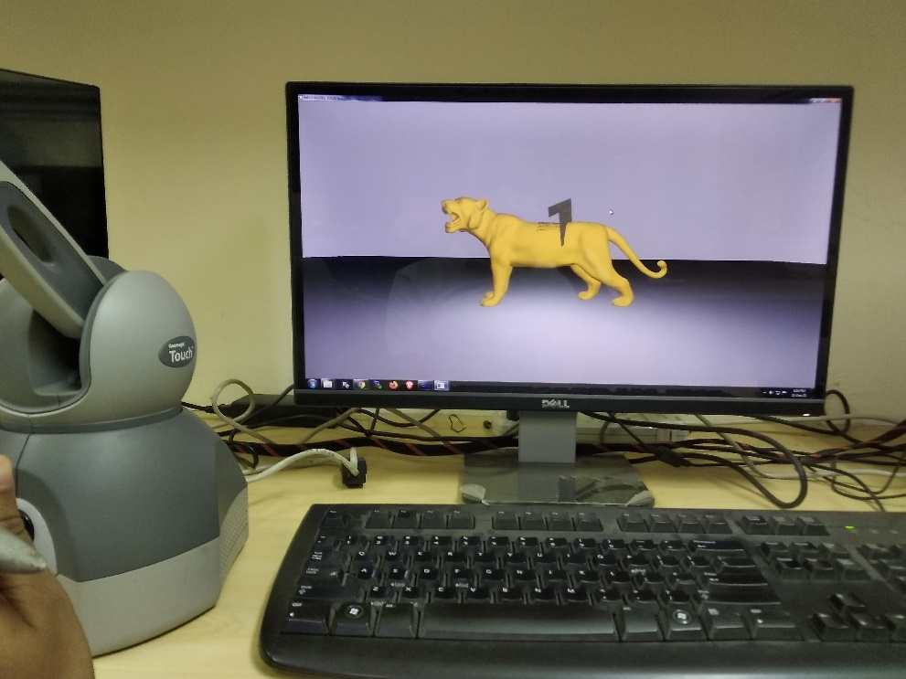
User Study
ANOVA Study
Visual On & Haptics On (Strategy 1)
Visual On & Haptics Off (Strategy 2)
Visual Off & Haptics On (Strategy 3)
Compared Strategies | p-values
1 vs 2 | 0.00065
1 vs 3 | 0.00001
Parameters | Mean | Median | Std
Vis on, Hap on | 4.71 | 4.65 | 0.23
Vis on, Hap off | 4.27 | 4.35 | 0.26
Vis off, Hap on | 2.79 | 2.85 | 0.43

Slide 22
User Study
Double Stimulus Comparison Study
Realism
Visual-haptics synchronization
Physical consistency
Parameters | Mean | Median | Std
Realism | 4.68 | 4.70 | 0.34
Vis-Hap sync | 4.85 | 5.00 | 0.22
Phys. Consistency | 4.51 | 4.50 | 0.29

Slide 23
Conclusion & Future work
Summary
We build a physics-based virtual sculpting framework for soft, deformable objects with real-time, accurate haptic feedback.
Future Work
System matrix size of Is-XFEM increases with increasing number of cuts.
Develop a solution whose run-time is independent of the number of cuts.

Slide 24
Thank You

Slide 25
References
Dan Koschier, Jan Bender, and Nils Thuerey. 2017. Robust eXtended finite elements for complex cutting of deformables. ACM Trans. Graph. 36, 4, Article 55 (August 2017), 13 pages. DOI:https://doi.org/10.1145/3072959.3073666
F. M. Chitalu, Q. Miao, K. Subr, and T. Komura, “Displacement-correlated xfem for simulating brittle fracture,” Computer Graphics Forum, vol. 39, no. 2, pp. 569-583, 2020.
Wu, J., & Li, F. (2015). An improved stable XFEM (Is-XFEM) with a novel enrichment function for the computational modeling of cohesive cracks. Computer Methods in Applied Mechanics and Engineering, 295, 77-107.
M. Ortega, S. Redon and S. Coquillart, "A Six Degree-of-Freedom God-Object Method for Haptic Display of Rigid Bodies with Surface Properties," in IEEE Transactions on Visualization and Computer Graphics, vol. 13, no. 3, pp. 458-469, May-June 2007, doi: 10.1109/TVCG.2007.1028.
H. Xu and J. Barbič, "6-DoF Haptic Rendering Using Continuous Collision Detection between Points and Signed Distance Fields," in IEEE Transactions on Haptics, vol. 10, no. 2, pp. 151-161, 1 April-June 2017, doi: 10.1109/TOH.2016.2613872.
Hui Chen and Hanqiu Sun. 2002. Real-time haptic sculpting in virtual volume space. In Proceedings of the ACM symposium on Virtual reality software and technology. Association for Computing Machinery, New York, NY, USA, 81–88. DOI:https://doi.org/10.1145/585740.585755
Zhan Gao and Ian Gibson. 2006. Haptic Sculpting of Multi-Resolution B-Spline Surfaces with Shaped Tools. Comput. Aided Des. 38, 6 (jun 2006), 661–676.
Robert Jagnow and Julie Dorsey. 2002. Virtual Sculpting with Haptic Displacement Maps. In Proceedings of the Graphics Interface 2002 Conference, May 27-29, 2002, Calgary, Alberta, Canada. 125–132
Matthias Müller and Markus Gross. 2004. Interactive virtual materials. In Proceedings of Graphics Interface 2004 (GI '04). Canadian Human-Computer Communications Society, Waterloo, CAN, 239–246.
S. Patkar and P. Chaudhuri, "Wetting of Porous Solids," in IEEE Transactions on Visualization and Computer Graphics, vol. 19, no. 9, pp. 1592-1604, Sept. 2013, doi: 10.1109/TVCG.2013.8.
Avirup Mandal, Parag Chaudhuri, and Subhasis Chaudhuri. 2021. Physics-based Mesh Deformation with Haptic Feedback and Material Anisotropy. arXiv:cs.GR/2112.04362

