Slide 1
Real-time Physics-based Mesh Deformation with Haptic Feedback and Material Anisotropy
VISIGRAPP 2023
Avirup Mandal, Parag Chaudhuri, Subhasis Chaudhuri
Indian Institute of technology bombay

Slide 2
Motivation
Physics-based model
Traditional shape editing tools do not render haptic feedback.
Most of these tools edit shapes in a purely geometric way.
Make the virtual shape editing experience more accurate & immersive.
Haptic feedback
Virtual Shape Editing

Slide 3
Contributions
Developed a deformable wetting model to change the material properties.
Multi-resolution framework and part of the simulations are parallelized using GPU to meet the real-time constraints.
Haptic and visual feedback using a multi-threaded method.
3

Slide 4
Deformation & Wetting
Simulate Corotated FEM based deformation with linear Cauchy strain on volumetric tetrahedral mesh. [Müller et el. 2004]
Wetting brush that transfer water from the brush to mesh. [Patkar et al. 2013]
Water gets diffused between neighboring tetrahedra. [Patkar et al. 2013]
Increasing the water content inside a tetrahedral element makes the material more malleable.
4

Slide 5
Change of material property by Wetting
Changing the water content inside a mesh we make part of the mesh more malleable. This is our way of modelling anisotropy.
The Voigt upper bound on the elasticity tensor of a solid-fluid mixture.
$$C^{V}=\left(1−φ\right)C^{s}+φC^{w}$$
The Reuss lower bound on the compliance tensor of a solid-fluid mixture.
$$S^{R}=\left(1−φ\right)S^{s}+φS^{w}$$
The Voigt and Reuss bounds together give the bound on the effective elasticity tensor.
$${\left(S^{R}\right)}^{−1}≤C^{eff}≤C^{V}$$
The effective compliance tensor for the solid-fluid mixture with any kind of solid and fluid. Thus the effective material strength goes down after adding water.
$$S^{eff}=\left[1+φ{\left(Q^{w}−P^{w}\right)}^{−1}\right]S^{s}, Q^{w}={\left(C^{s}−C^{w}\right)}^{−1}C^{s}$$
5

Slide 6
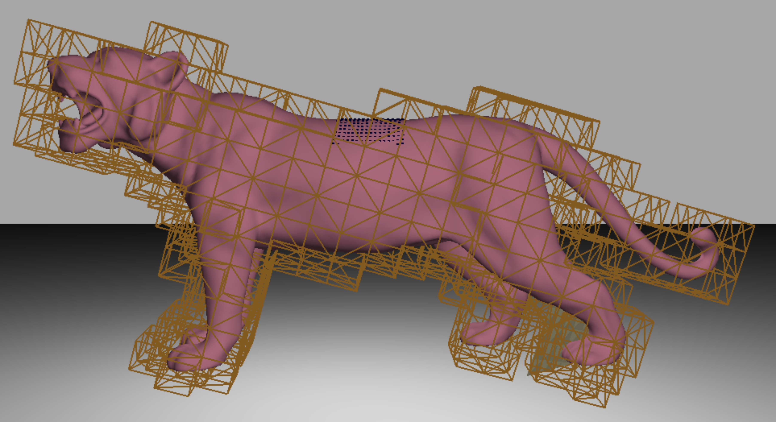
Multi-resolution Simulation Framework
Problem:
High-resolution mesh slows down the simulation speed.
Low-resolution mesh affects visual fidelity.
Solution:
Embed a high-resolution triangular surface mesh for visualization inside a low-resolution tetrahedral volume mesh.
Manipulations are first performed on the low-resolution mesh.
Transferred to the high-resolution mesh using barycentric co-ordinates.
6

Slide 7
Multi-threaded Framework
Continuous collision detection between haptic tools and outer-surface of the mesh.
Problem:
HAPTICS
THREAD
VISUAL
THREAD
Smooth haptics feedback requires 1000 frames/sec update.
Visual feedback requires at least 60 frames/sec.
Solution:
Two parallel threads: Haptics & Visual.
Synchronization: shared memory.
Rapid update of forces on haptics thread by filtering.
SHARED MEMORY
7

Slide 8
Continuous collision detection
Continuous collision detection between haptic tool and outer-surface of the mesh being manipulated.
8

Slide 9
Continuous collision detection
Continuous collision detection between haptic tool and outer-surface of the mesh being manipulated.
9

Slide 10
Continuous collision detection
Continuous collision detection between haptic tool and outer-surface of the mesh being manipulated.
10

Slide 11
Continuous collision detection
Continuous collision detection between haptic tool and outer-surface of the mesh being manipulated.
11

Slide 12
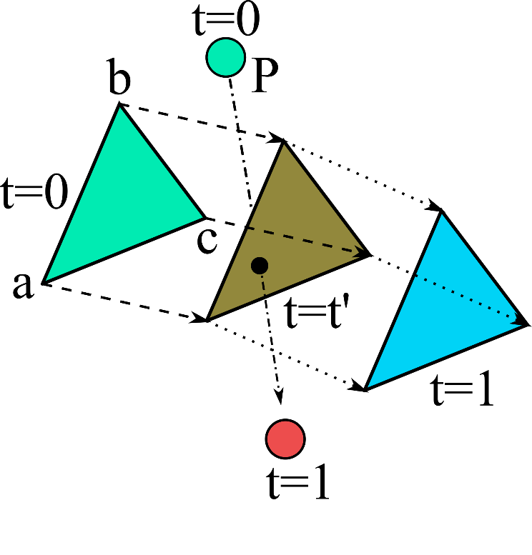
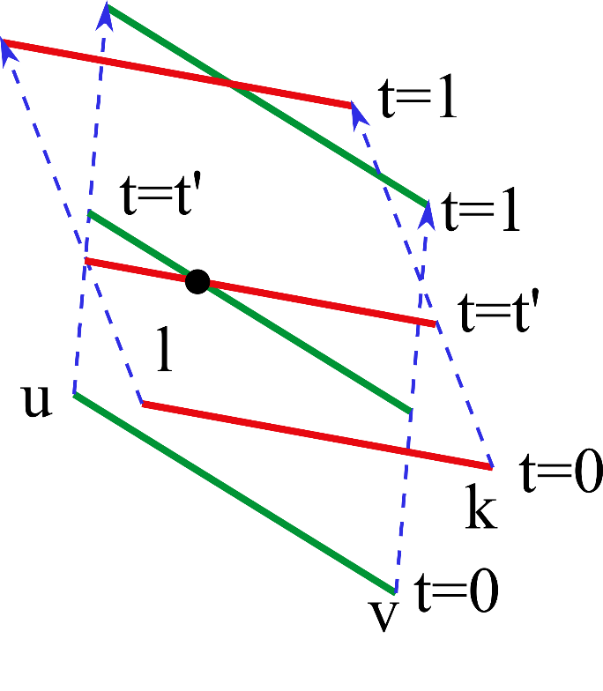
Haptic Force Feedback
Calculate Vertex-Face penalty force as
$$I_{p}^{VF}=k_{vf}\sum_{i=0}^{i<N}{\int_{t_{a}^{i}}^{t_{b}^{i}}{n_{t}^{T}}(p_{t}−q_{t})n_{t}dt}$$
Calculate Edge-Edge penalty force
$$I_{p}^{EE}=k_{ee}\sum_{i=0}^{i<N}{\int_{t_{a}^{i}}^{t_{b}^{i}}{n_{E_{t}}^{T}}(p_{t}−q_{t})n_{E_{t}}dt}$$
12

Slide 13
Results: Push & pull deform
13

Slide 14
Results: Wet
14

Slide 15
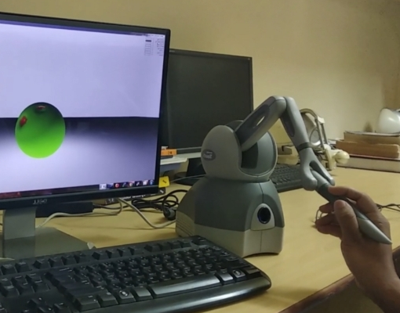
User Study
ANOVA Study
Visual On & Haptics On (Strategy 1)
Visual On & Haptics Off (Strategy 2)
Visual Off & Haptics On (Strategy 3)
Compared Strategies | p-values
1 vs 2 | 0.00070
1 vs 3 | 0.00001
Parameters | Mean | Median | Std
Vis on, Hap on | 4.63 | 4.71 | 0.26
Vis on, Hap off | 4.12 | 4.27 | 0.28
Vis off, Hap on | 2.62 | 2.75 | 0.51
15

Slide 16
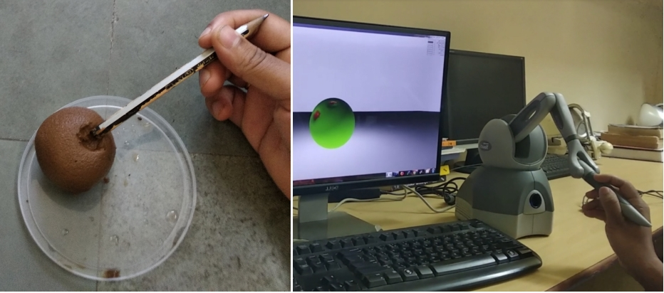
User Study
Double Stimulus Comparison Study
Realism
Visual-haptics synchronization
Physical consistency
Parameters | Mean | Median | Std
Realism | 4.61 | 4.65 | 0.35
Vis-Hap sync | 4.72 | 4.90 | 0.25
Phys. Consistency | 4.48 | 4.50 | 0.29
16

Slide 17
Discussion
Summary
We build a physics-based virtual shape editing framework for soft, deformable objects with real-time, accurate haptic feedback.
Changing the water content inside the material we can make an object more malleable.
Future Work
There is no provision for adding more meshes on top of the initial mesh and cannot thus model the functionality of material deposition. In future, we want to work in this direction.
17

Slide 18
Thank you
https://avirupmandal.github.io/

