Slide 1
Galerkin Enhanced Graph-based FEM for Interactive Fracture and Sculpting Applications
VISIGRAPP 2025
Avirup Mandal, Parag Chaudhuri, Subhasis Chaudhuri
Indian Institute of technology Palakkad
Indian Institute of technology bombay

Slide 2
Motivation
Fracture simulation is crucial in various graphics applications: video games, mixed reality experiences, and surgical simulators.
FEM, MPM, BEM utilize an implicit time integration scheme - computationally expensive, and it increases with the number of cracks in the object mesh.
Not suitable for real-time simulations with high-resolution objects.

Slide 3
Galerkin enhanced graph-based FEM
Galerkin multigrid method can run simulation for high resolution meshes (~ 600k) at an interactive rate by CUDA parallelization
Graph-based FEM can render fracture/cutting with negligible computational overhead
Combining them together we can design interactive fracture/cutting framework!!
3

Slide 4
Contributions
Combined the Galerkin multigrid method with a graph-based Finite Element Method to develop a physically based fracture and cutting algorithm that can run at interactive rates.
Part of the simulations are parallelized using GPU to meet the real-time constraints.
Developed an interactive cutting and sculpting application.
Conducted a user study to validate the physical plausibility, ease of use, and responsiveness of the developed application and method.
4

Slide 5
Graph-based Finite Element Method
Remeshing-Free Graph-Based Finite Element Method for Fracture Simulation. A. Mandal, P. Chaudhuri, and S. Chaudhuri. Computer Graphics Forum. 2023.
Scalable Visual Simulation of Ductile and Brittle Fracture. A. Mandal, P. Chaudhuri, and S. Chaudhuri. ACM SIGGRAPH Posters. 2021.

Slide 6
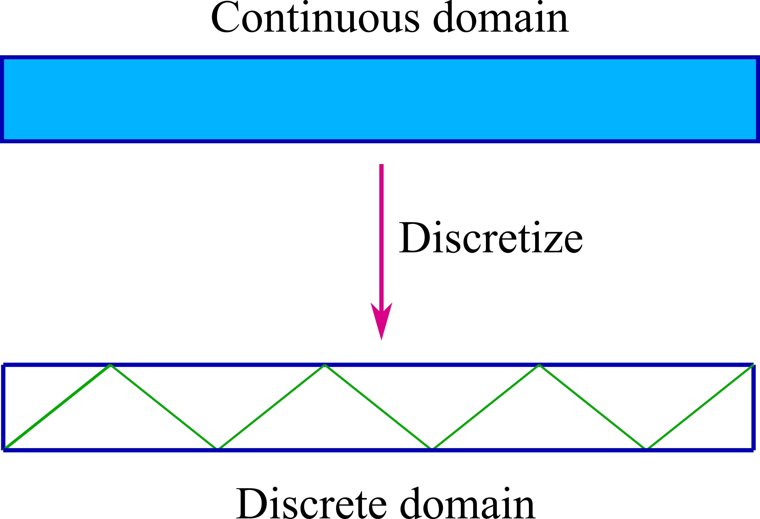
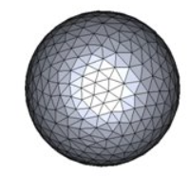
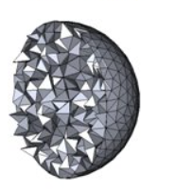
What is Finite Element Method?
Method to numerically solve differential equations that generally appear in engineering, mathematics and physics.
Overview of FEM
Approximate a continuous domain with finite number of discrete elements
Elements can be triangular/square for 2D domain or tetrahedral/cube for 3D domain
3D mesh is a royalty-free image from shutterstock.com

Slide 7
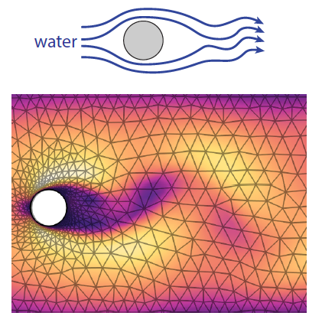
What is Finite Element Method?
Method to numerically solve differential equations that generally appear in engineering, mathematics and physics.
Overview of FEM
Approximate a continuous domain with finite number of discrete elements
Elements can be triangular/square for 2D domain or tetrahedral/cube for 3D domain
An unknown function is approximated over this finite domain and solved using an iterative method by minimizing an error
Simulating object deformation and fracture with FEM
Image Courtesy: Pfaff et al., Learning Mesh-Based Simulation with Graph Networks, ICLR 2021

Slide 8
Deformation with FEM
External force causes the object change the shape
Deformed object generates internal hyper-elastic strain energy, $ψ$
Internal strain energy produces internal elastic forces which helps the object to recover its original shape

Slide 9
Mathematical model for FEM
$u$ is displacement field over the domain of the object
Using classical mechanics$M\ddot{u}+ f^{int}=f^{ext} ≡\sum_{e∈N}{m_{e}\ddot{u}}+\sum_{e∈N}{f_{e}^{int}}=\sum_{e∈N}{f_{e}^{ext}}$
Apply suitable numerical integration technique to solve the system dynamics
$$f_{e}^{int}=\int{\frac{∂ψ}{∂u}dζ}$$
Internal force = Partial derivative of internal strain energy w.r.t. displacement field and integrated over the element domain

Slide 10
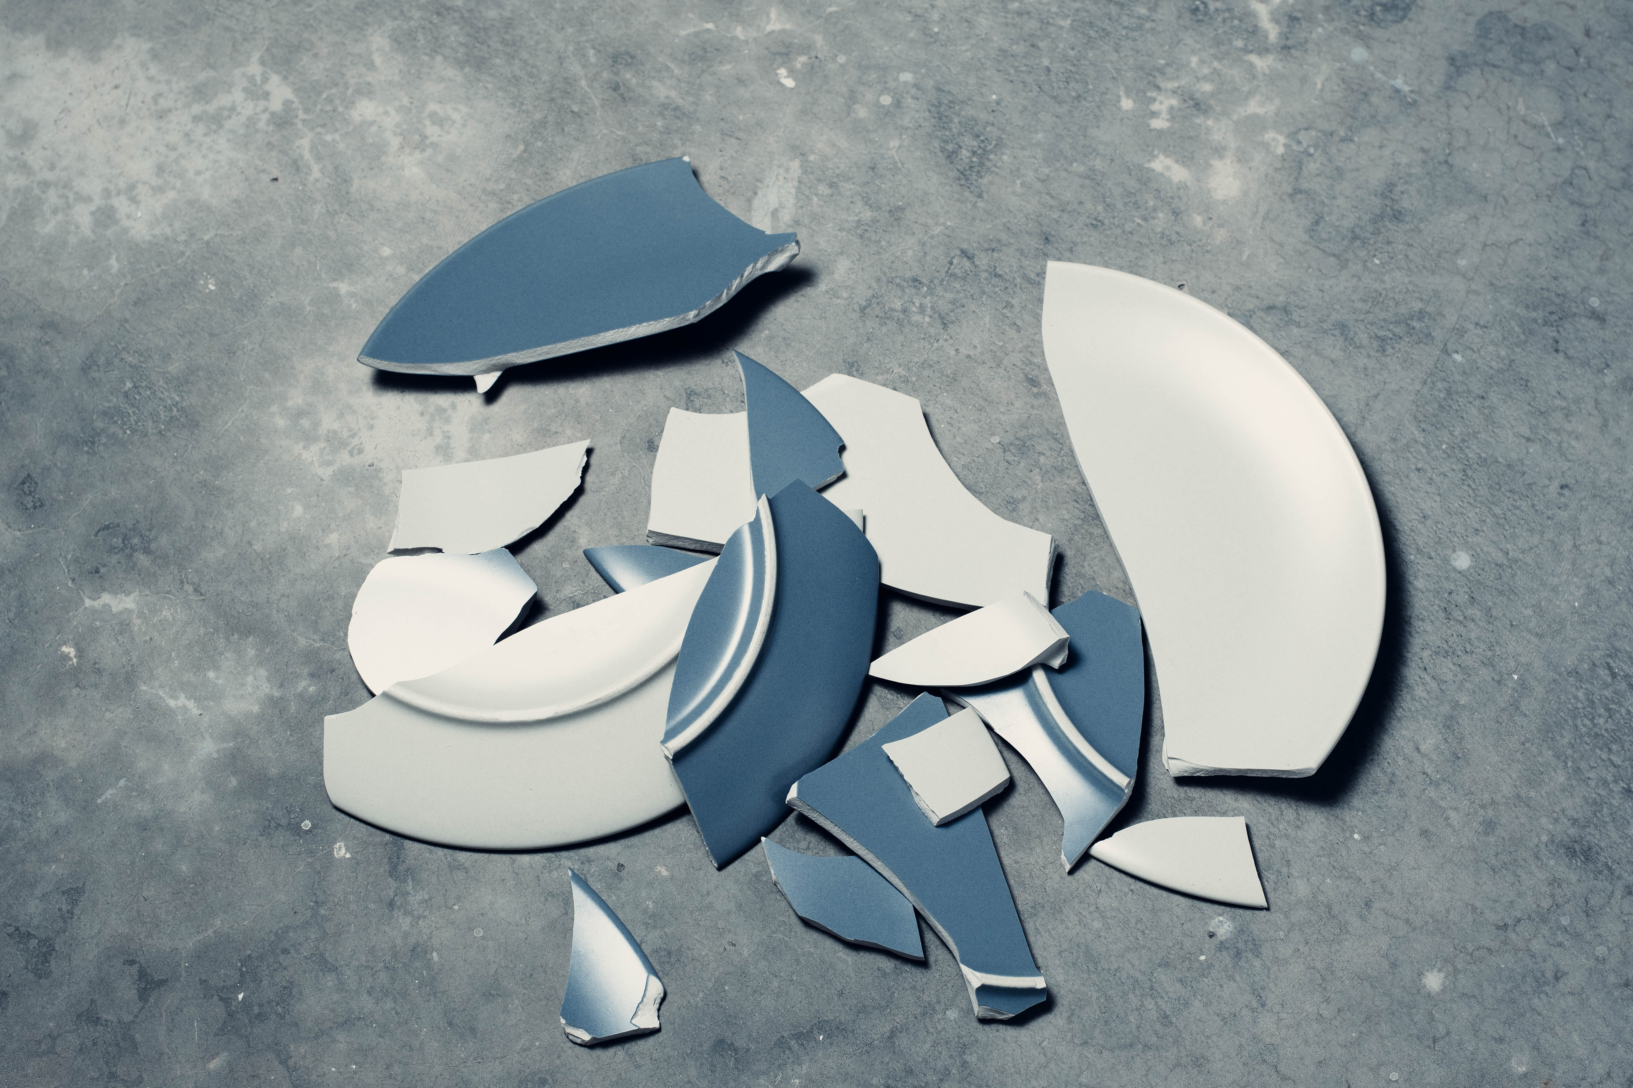
Challenges for Fracture
Major Bottlenecks
Remeshing whenever a new crack appears
Increases the number of elements and system matrix size
$$M\ddot{u}+ f^{int}=f^{ext} ≡\sum_{e∈N}{m_{e}\ddot{u}}+\sum_{e∈N}{f_{e}^{int}}=\sum_{e∈N}{f_{e}^{ext}}$$
Simulation gets slower
Graph-based FEM for fracture simulation of ductile and brittle materials in mesh-based objects addresses this bottleneck
Shattered plate is a royalty-free image from unsplash.com

Slide 11
Graph-based FEM for Fracture
Given an object

Slide 12
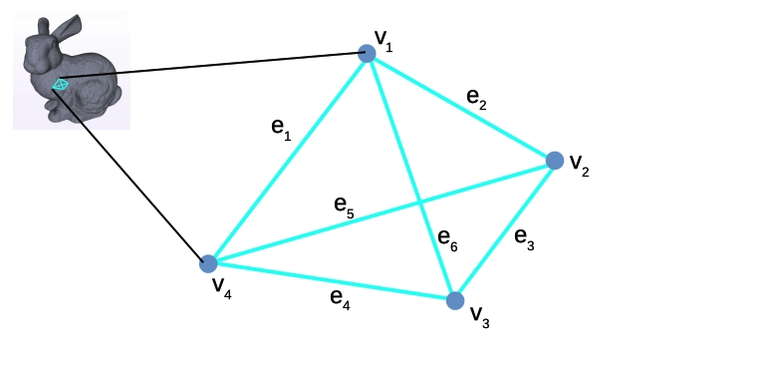
Graph-based FEM for Fracture
Given an object, represented as a volumetric mesh with tetrahedral elements

Slide 13
Graph-based FEM for Fracture
…we use the graph induced by the edges of the finite elements, between the vertices, for our FEM computations.

Slide 14
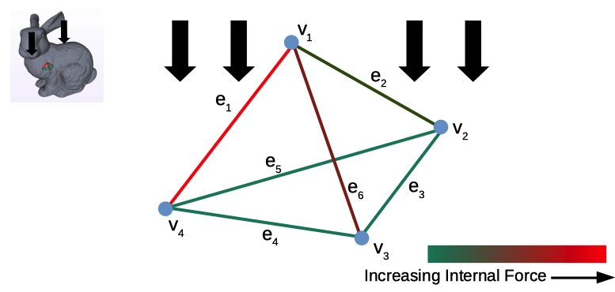
Graph-based FEM for Fracture
$$σ_{mn}^{e}=\sum_{i,j∈\{x,y,z\}}{σ_{ij}^{e}}\cos{θ_{i}}\cos{θ_{j}}$$
External load cause internal stress, which are resolved along edges of the graph.

Slide 15
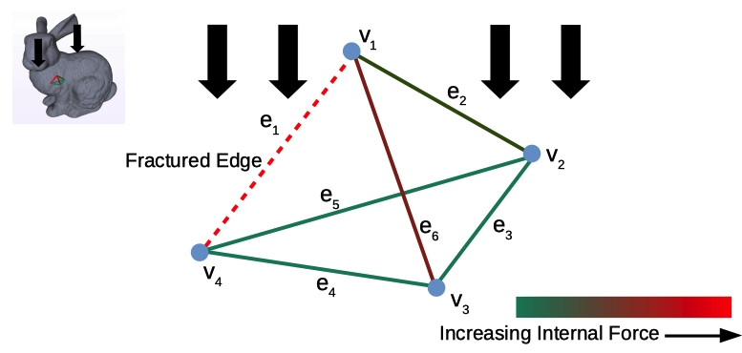
Graph-based FEM for Fracture
$$Ψ_{frac}^{e}=f\left(φ_{l},Ψ^{e}\right)$$
$$f_{e}^{int}=\int{\frac{∂ψ^{e}}{∂u}dζ}$$
$$f_{e}^{int}=\int{\frac{{∂ψ}_{frac}^{e}}{∂u}dζ}$$
When stress in an edge exceeds a critical threshold, it is labeled as fractured and the internal energy of the system is reformulated, without any remeshing.

Slide 16
Loaf of Bread

Slide 17
Galerkin Enhanced Graph-based Finite Element Method

Slide 18
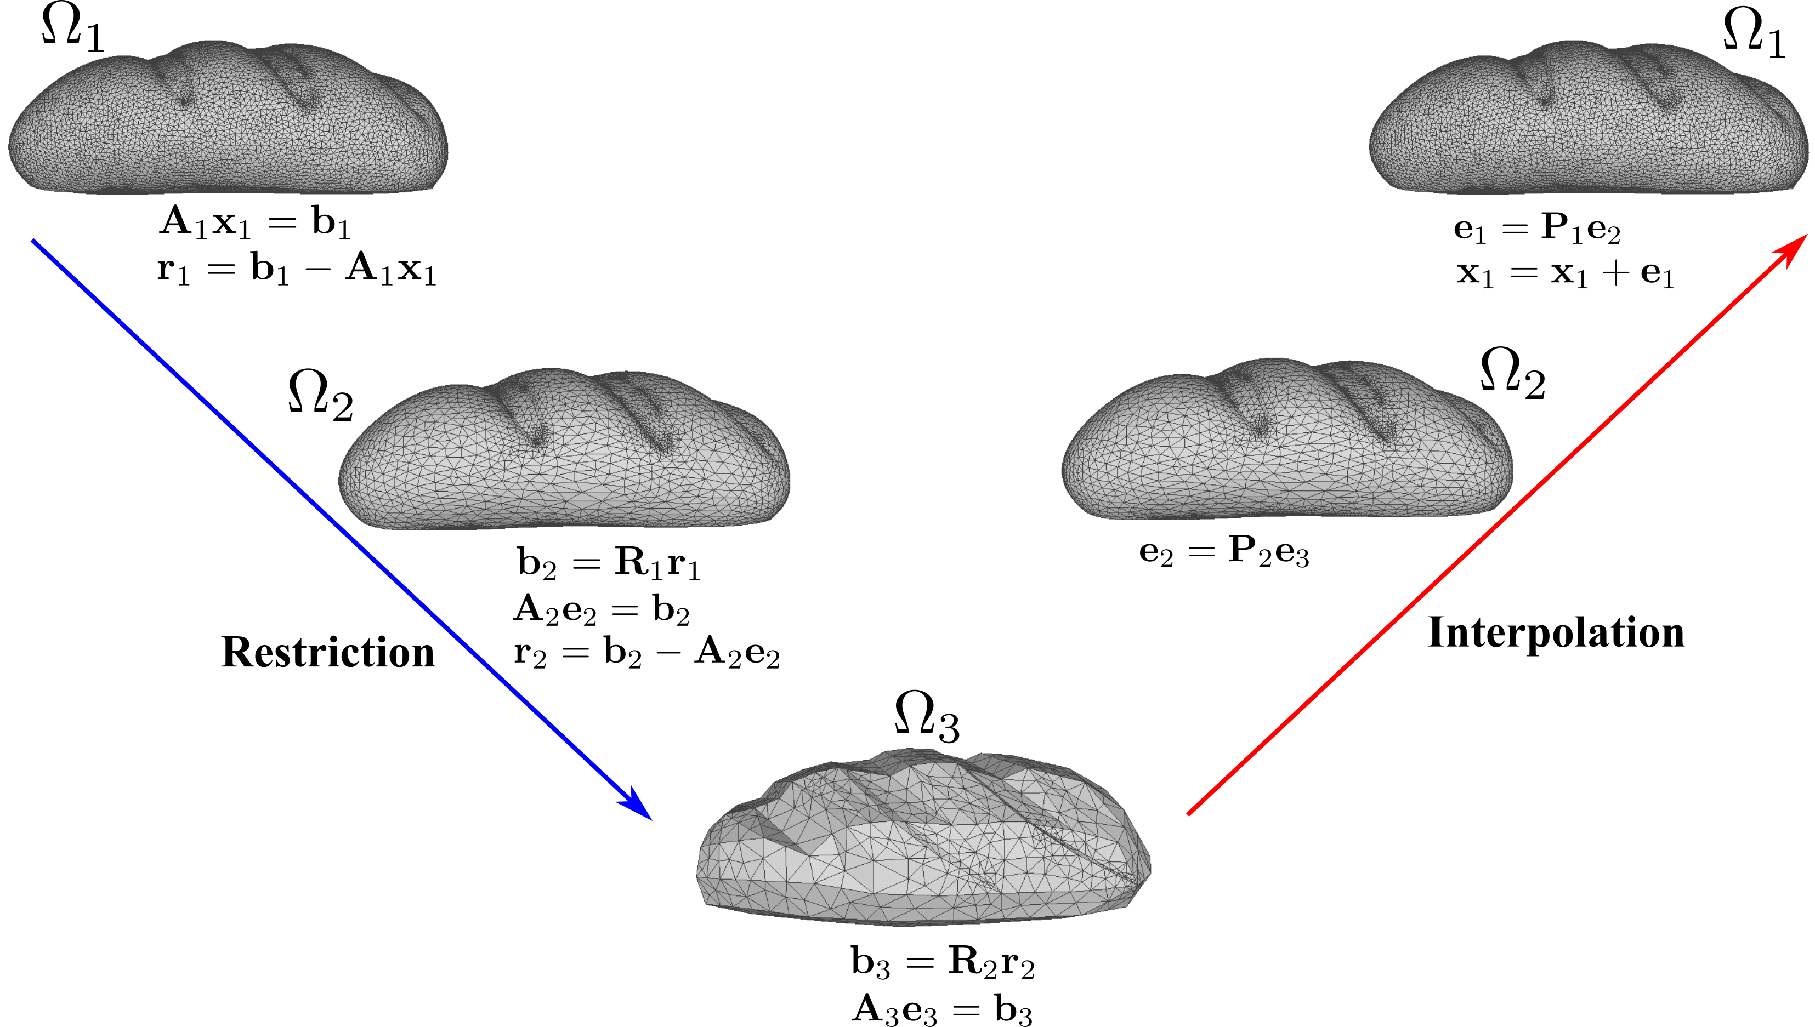
Galerkin Multigrid Method
Early Termination !!
Fully Solved !!
18

Slide 19
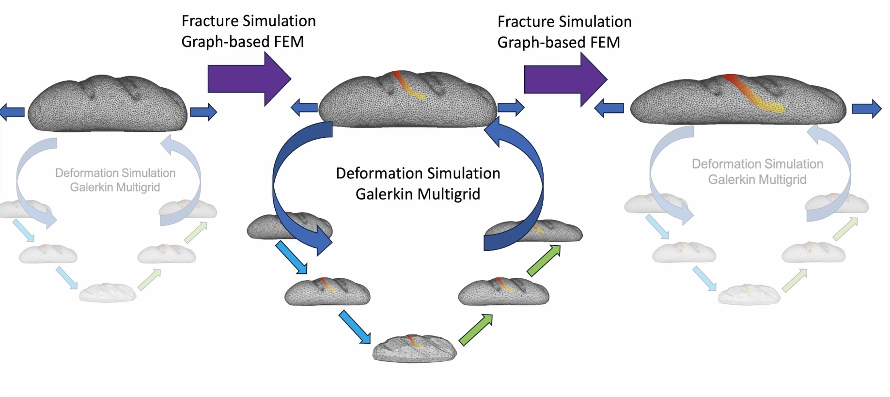
Galerkin-Enhanced Graph-FEM
19

Slide 20
Galerkin Multigrid Method: Grid hierarchy
Vertices at each grid level is selected using the furthest point sampling method
Parallelize the whole process on GPU using CUDA multithreading architecture
20

Slide 21
Interactive sculpting: Deformation
21

Slide 22
Interactive sculpting: Cutting
22

Slide 23
Comparison: Galerkin vs Graph-based FEM
23

Slide 24
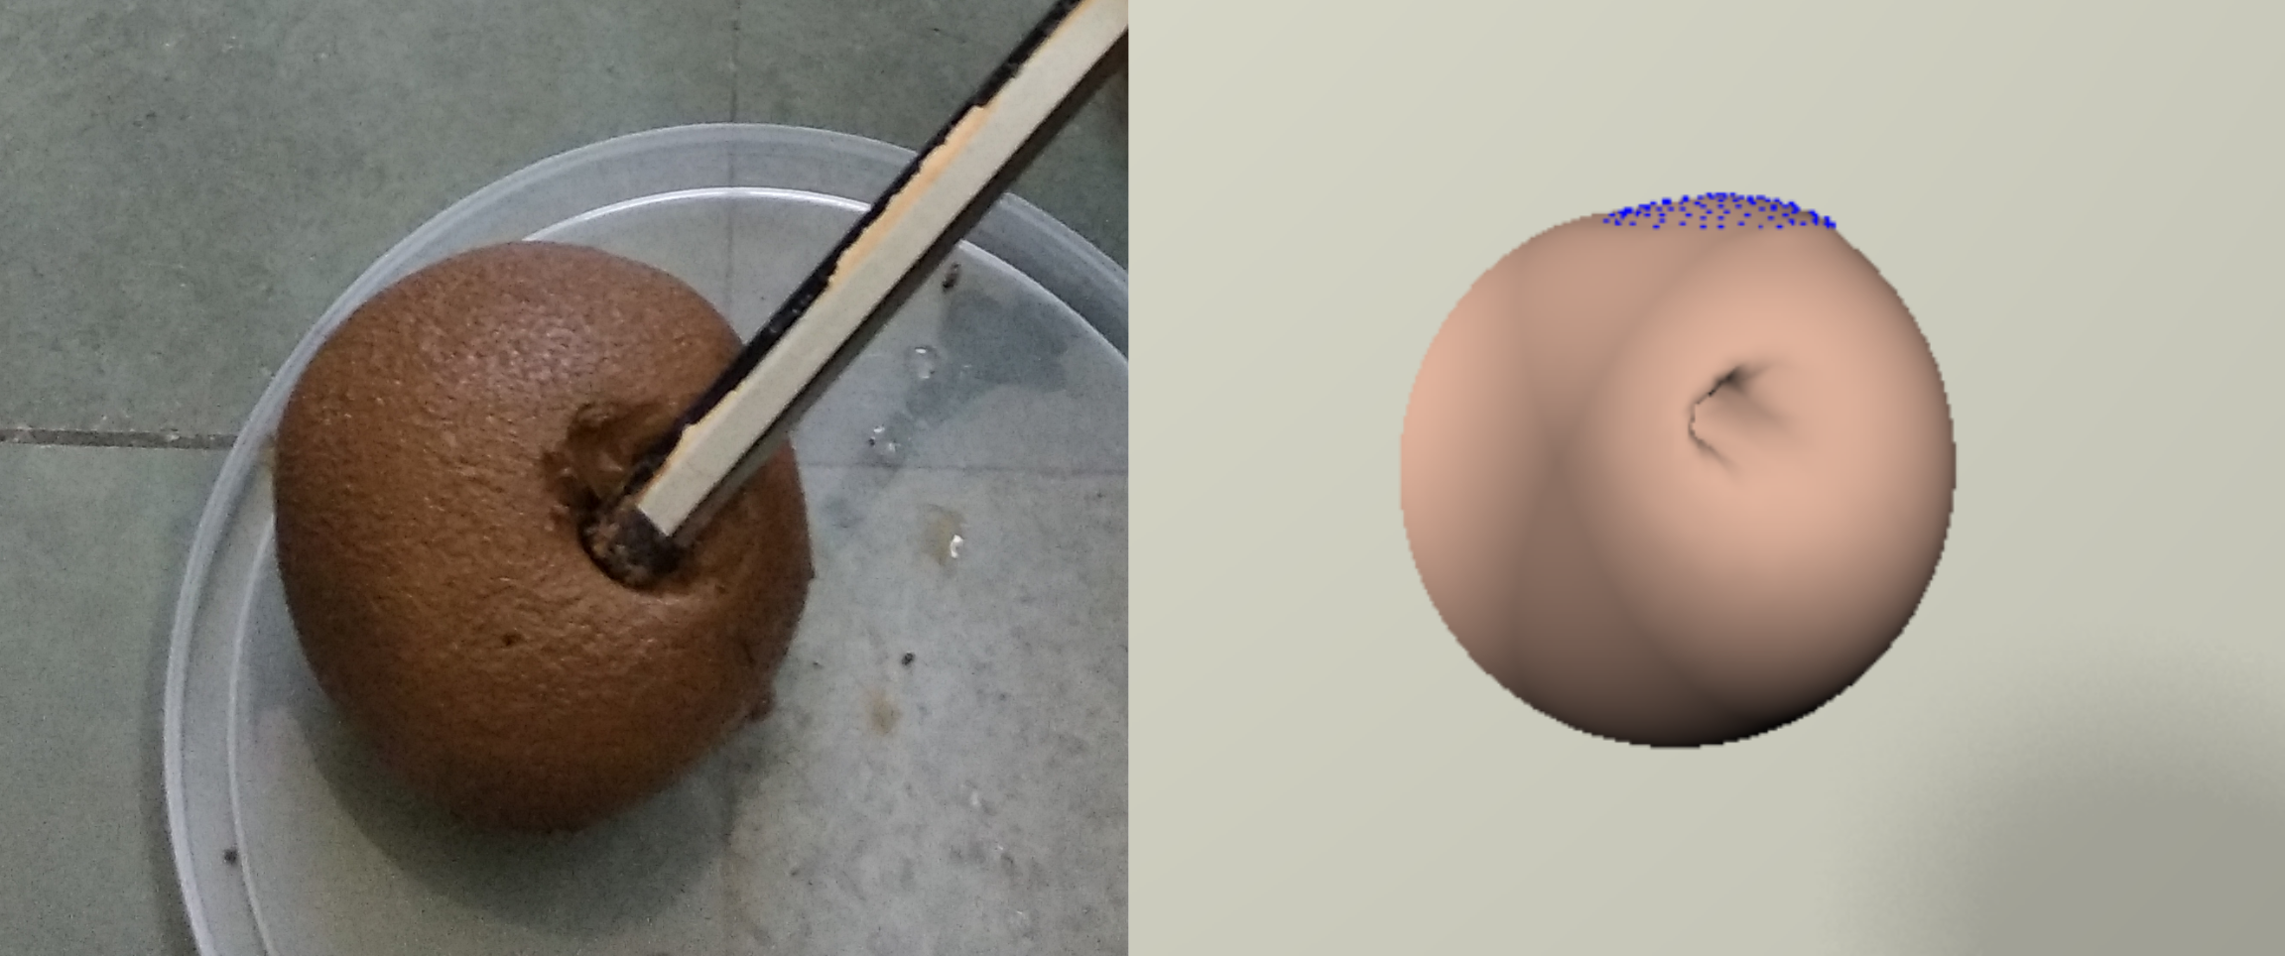
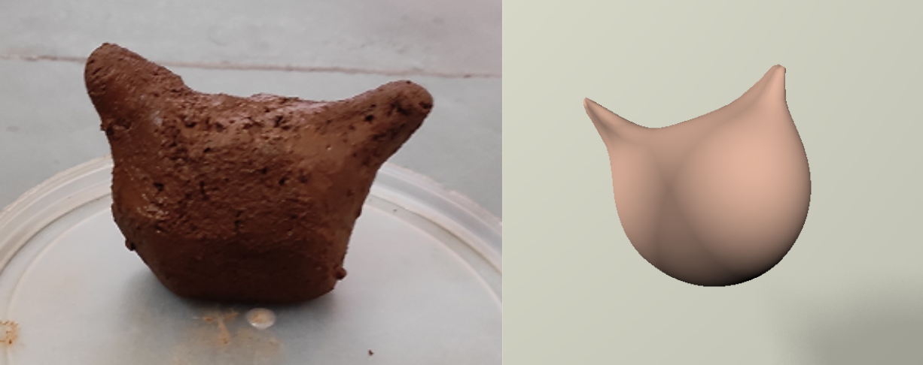
User Study
Comparison Study with Blender
Physical realism
Ease of use
Responsiveness
Parameters | Mean(Bl) | Median(Bl) | Std(Bl)
Realism | 8.45(9.25) | 8.75(9.00) | 0.43(0.26)
Ease of use | 8.85(9.75) | 9.00(10.0) | 0.61(0.26)
Responsiveness | 9.35(9.90) | 9.00(10.0) | 0.58(0.22)
24

Slide 25
Discussion
Summary
Our work introduces a Galerkin-enhanced graph-based FEM algorithm for interactive, real-time fracture and cutting simulation.
Using this algorithm, we develop an interactive virtual sculpting framework and present various dynamic simulation scenarios to demonstrate its effectiveness and usability.
Future Work
A promising future research direction is enhancing volume preservation accuracy while maintaining real-time performance.
25

Slide 26
Thank you
https://avirupmandal.github.io/interactive-fracture-grapp2025/

